Slide 1

Project Title - Steganography – Hiding Message in an Image
VEDIKA NAIDU

Slide 2

PROBLEM STATEMENT
Secure communication is important in today's digital world.
Traditional encryption protects data but still reveals that communication exists.
There is a need for techniques to hide the existence of sensitive information.
Steganography helps hide messages inside images to ensure privacy and security.

Slide 3
Project Description • This project demonstrates steganography by hiding a secret message inside an image. • The message is embedded into image pixels using encoding techniques. • The hidden message is invisible to the human eye. • The project also includes decryption to retrieve the original message. • It ensures secure and hidden communication.

Slide 4

WHO ARE THE END USERS?
Cybersecurity Students
Data Security Professionals
Ethical Hackers
Researchers
Organizations requiring secure communication

Slide 5

Technology Used
Python Programming Language
Libraries:
PIL / Pillow (Image Processing)
OpenCV (optional)
File Handling
Basic Encryption & Decryption Techniques

Slide 6
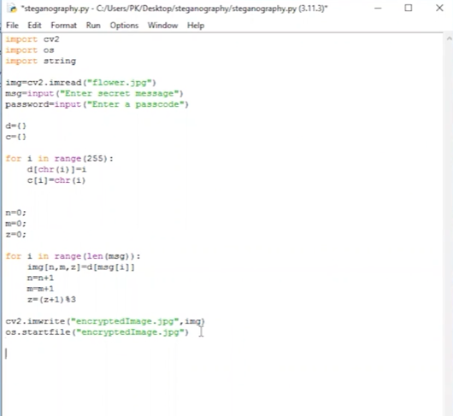
RESULTS
[Add screen shots of your code ]
Demo Link

Slide 7
Thank you
.
.

